Slide 1
Unit 3 Resistance & Ohm’s Law
Part A: Resistance
Notes:
Hi! Welcome to Unit 3: Resistance and Ohm’s Law, Part A on Resistance.

Slide 2
What will you learn?
What is resistance?
Factors affect resistance value
Use of resistance
Different types of resistors

Slide 3
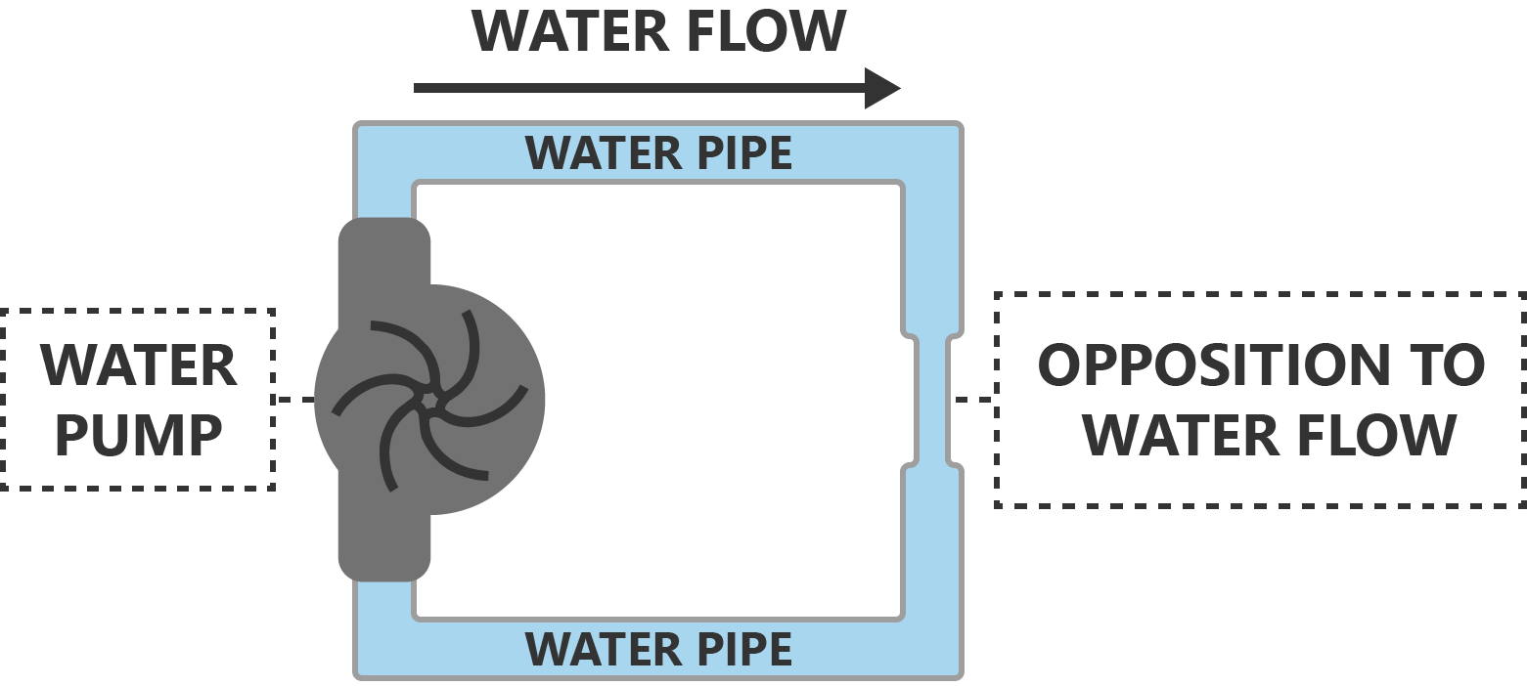

What is resistance?
Electric resistance is the hindrance to the flow of charges or current.
Analogy between water circulation system and electric circuit.
Copper wire is a good conductor because of large quantity of free electrons in it.
I
∼
+
V
−
Nichrome wire has much less free electrons in it, not a good conductor.
Nichrome wire restricts the current flow.

Slide 4
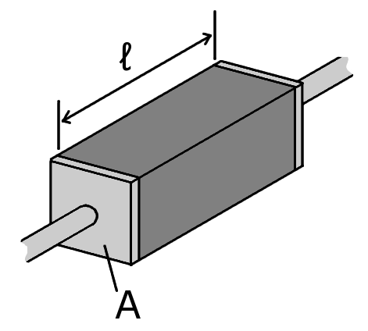
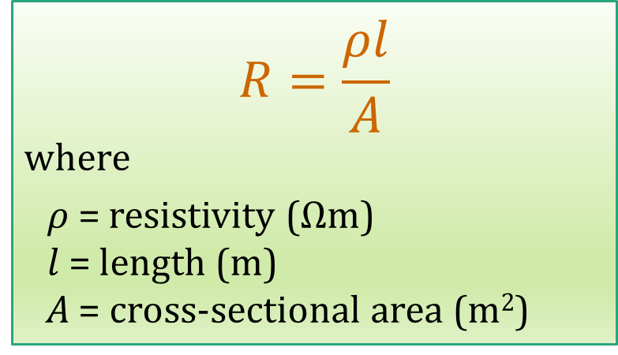
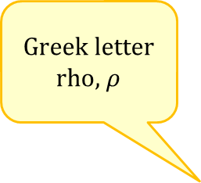
Factors affect Resistance
The symbol for resistance is R.
Unit of resistance: ohm (Ω).
$$R=\frac{ρl}{A}$$
where
$ρ$ = resistivity (Ωm)
$l$ = length (m)
A = cross-sectional area (m²)
Greek letter rho, $ρ$
CC-BY-SA-3.0
https://en.wikipedia.org/wiki/File:Resistivity_geometry.png

Slide 5

Factors affect Resistance
Different materials have different resistivities.
More free electrons ⇒ Lower resistance
Dimensions affect the resistance too.
Longer a wire ⇒ Higher the resistance
Thicker a wire ⇒ Lower the resistance
$$R=\frac{ρl}{A}$$
CC-BY-SA-3.0
https://en.wikipedia.org/wiki/File:Resistivity_geometry.png

Slide 6
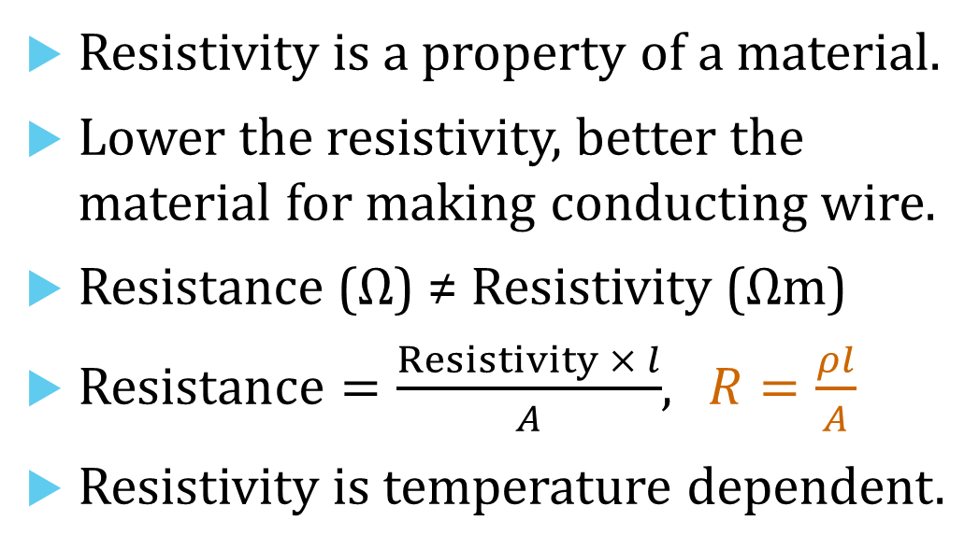
Resistivity
Resistivity is a property of a material.
Lower the resistivity, better the material for making conducting wire.
Resistance (Ω) ≠ Resistivity (Ωm)
$Resistance=\frac{Resistivity × l}{A}$, $R=\frac{ρl}{A}$
Resistivity is temperature dependent.
Material | Resistivity ρ (Ωm) at 20ºC
Silver | 1.59 × 10⁻⁸
Copper | 1.68 × 10⁻⁸
Aluminium | 2.65 × 10⁻⁸
Tungsten | 5.6 × 10⁻⁸
Iron | 9.71 × 10⁻⁸
Hard Rubber | 1.59 × 10¹³
PVC | 5.4 × 10¹⁵
PTFE or Teflon | 10 × 10²²

Slide 7


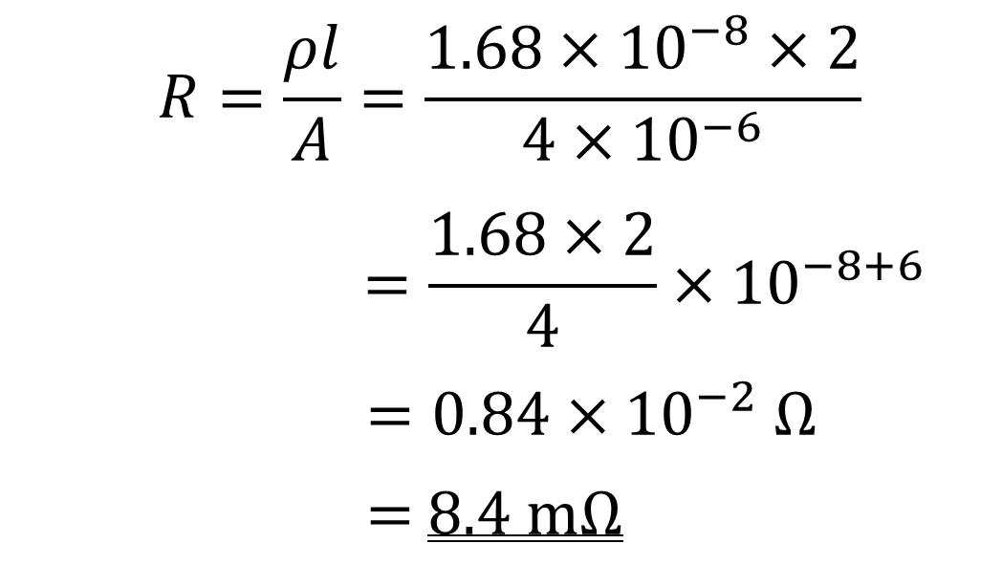
Example 1: A 2-m long copper wire has a uniform cross-sectional area of 4 mm². Given that resistivity of copper is 1.68 × 10⁻⁸ Ωm, determine its resistance.
Enter all data in SI units
$$R=\frac{ρl}{A}=\frac{1.68×{10}^{−8}×2}{4×{10}^{−6}}$$
$$=\frac{1.68×2}{4}×{10}^{−8+6}$$
$=0.84×{10}^{−2} Ω$
= 8.4 mΩ
Notes:
You have a camera sitting beside you. Its screen view indicates a low battery. You retract it and notice a label on it reads: 3.7 V, 1000 mAh; Minimum 940 mAh or 3.5 Wh.
Another big question for you.

Slide 8
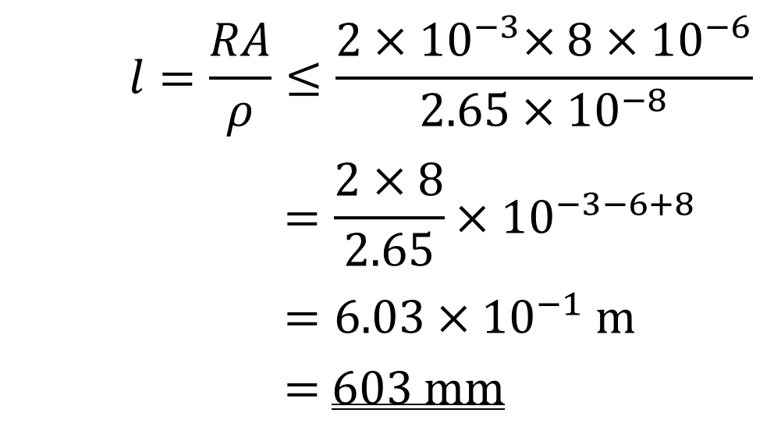
Example 2: An aluminium sheet with a uniform cross-sectional area of 8 mm² is used to form a common junction of two points in an electric circuit. The resistivity of aluminium is 2.65 × 10⁻⁸ Ωm. If the resistance of the sheet must not exceed 2 mΩ, determine the maximum length of the aluminium sheet.
$$l=\frac{RA}{ρ}≤\frac{2{×10}^{−3}×8×{10}^{−6}}{2.65×{10}^{−8}}$$
$$=\frac{2×8}{2.65}×{10}^{−3−6+8}$$
$$=6.03×{10}^{−1} m$$
= 603 mm
Notes:
You have a camera sitting beside you. Its screen view indicates a low battery. You retract it and notice a label on it reads: 3.7 V, 1000 mAh; Minimum 940 mAh or 3.5 Wh.
Another big question for you.

Slide 9

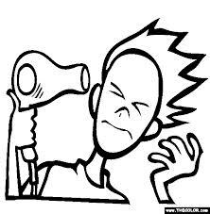
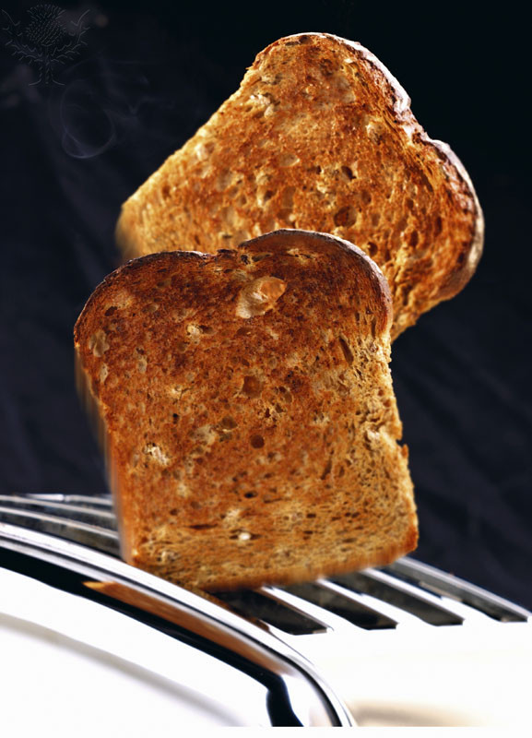
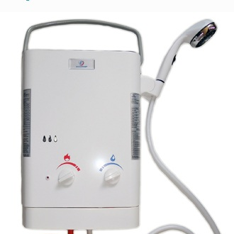
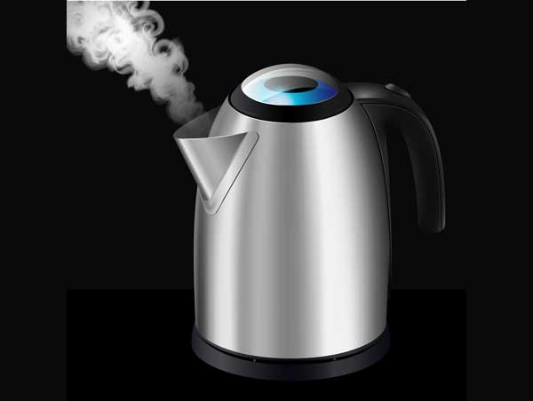
Use of Resistance
Resistance can generate heat (on purpose, of course) so that you can use it to
iron clothing
make toast
dry your hair
heat up water

Slide 10
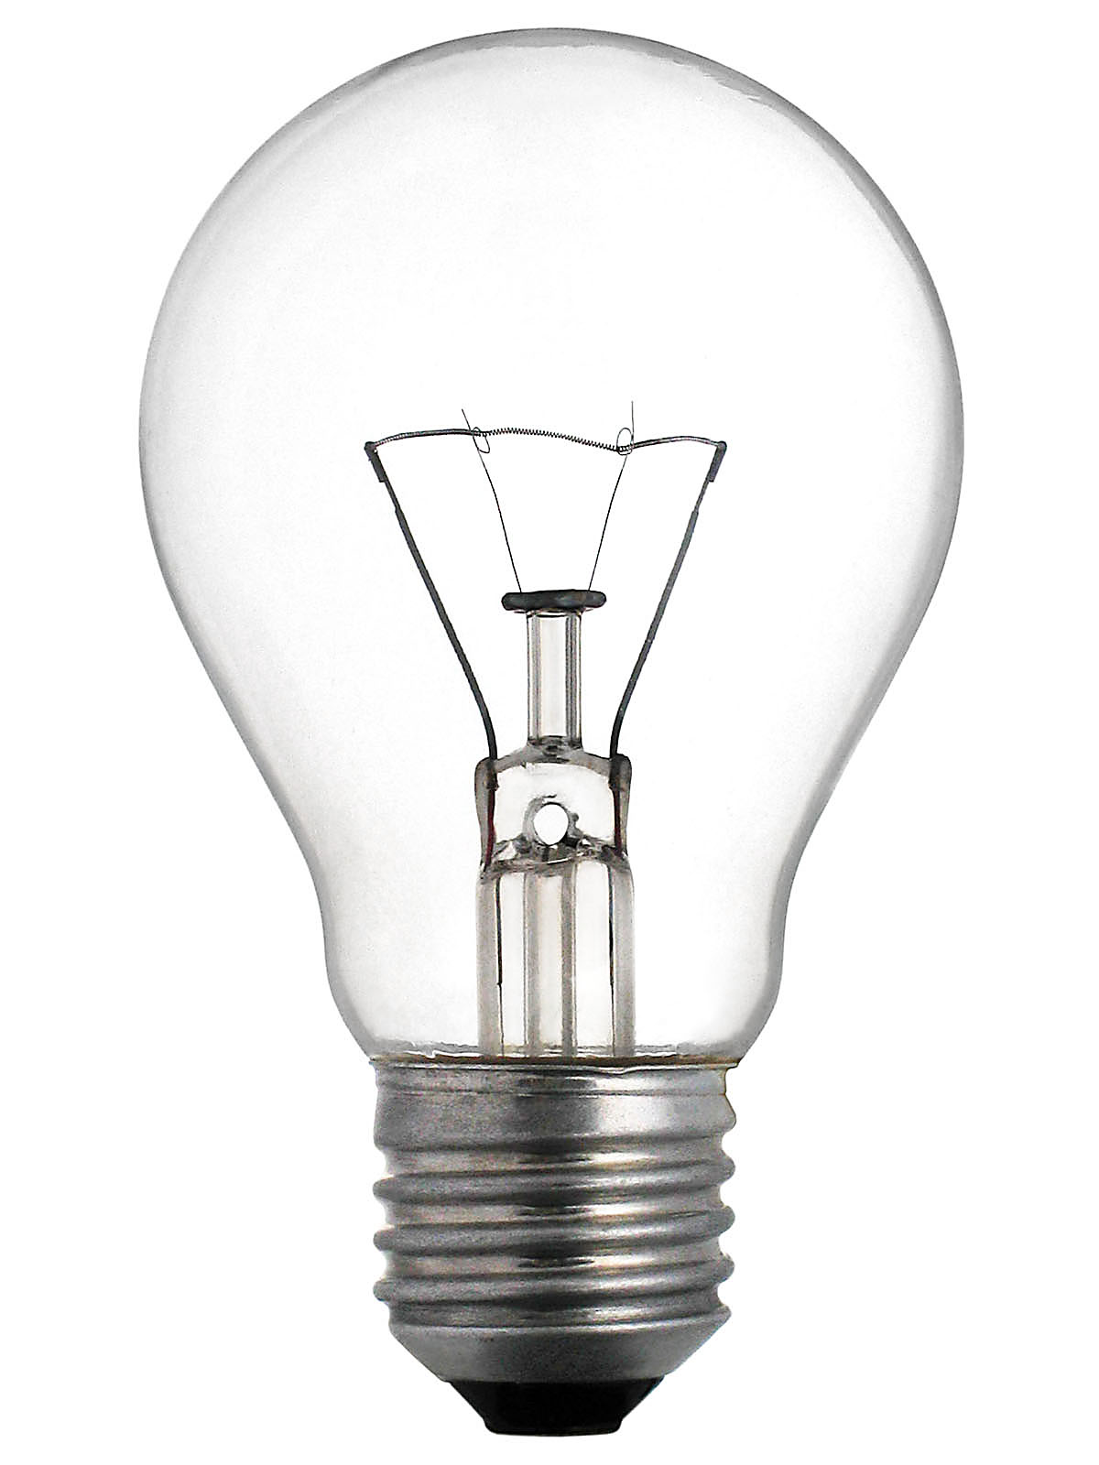
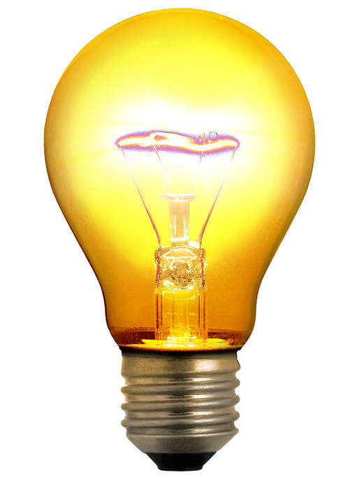
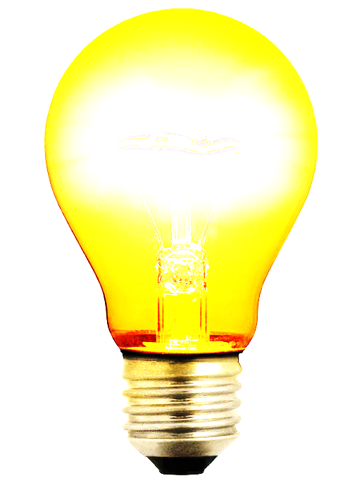
Use of Resistance
Other use:
To limit the current in a circuit.
Varying resistance can dim or brighten your room.
You can have resistance arrangements to produce current division and voltage division.

Slide 11
Resistor
3 Board Types of Resistors:
Wirewound resistors
Composition resistors
Film resistors
Notes:
You have a camera sitting beside you. Its screen view indicates a low battery. You retract it and notice a label on it reads: 3.7 V, 1000 mAh; Minimum 940 mAh or 3.5 Wh.
Another big question for you.

Slide 12
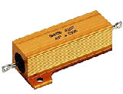
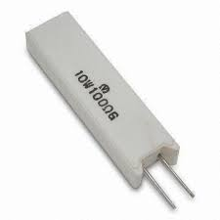
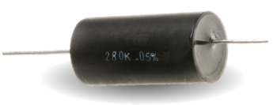
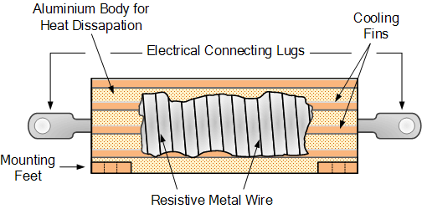
Resistor
Wirewound Resistor
Thin metal alloy (such as nichrome) wire wound onto a ceramic former in a spiral helix
Low resistance value, 0.01Ω to 100 kΩ
High precision value
Able to withstand high current and high power
Notes:
You have a camera sitting beside you. Its screen view indicates a low battery. You retract it and notice a label on it reads: 3.7 V, 1000 mAh; Minimum 940 mAh or 3.5 Wh.
Another big question for you.

Slide 13

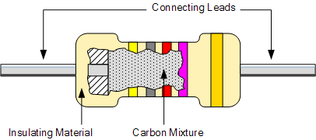
Resistor
Composition Resistor
Made of carbon dust or graphite paste.
Popular in the 60s & 70s.
Good for high frequency applications
Large tolerances, typically ±20%. 100 Ω ± 20% = 80 Ω to 120 Ω Lower tolerance, less deviation.
Notes:
You have a camera sitting beside you. Its screen view indicates a low battery. You retract it and notice a label on it reads: 3.7 V, 1000 mAh; Minimum 940 mAh or 3.5 Wh.
Another big question for you.

Slide 14
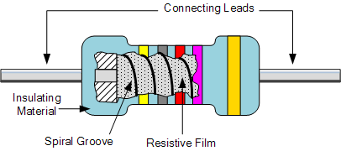

Resistor
Film Resistor
Carbon film, metal film, metal oxide film resistors
Resistance value is controlled by varying the thickness of the deposited film and by cutting the film in a helical manner along its length.
Low tolerance, as low as ±0.1% for some metal film resistors.
Notes:
You have a camera sitting beside you. Its screen view indicates a low battery. You retract it and notice a label on it reads: 3.7 V, 1000 mAh; Minimum 940 mAh or 3.5 Wh.
Another big question for you.

Slide 15
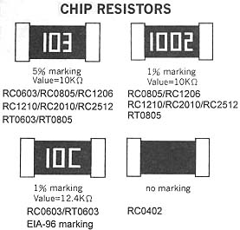
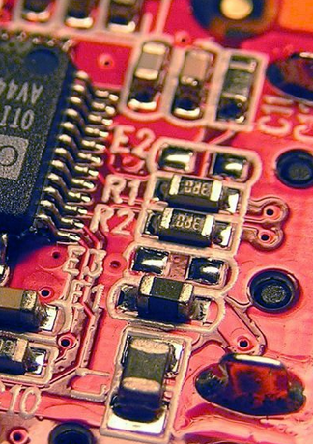
Resistor
SMT or SMD Film Resistor
SMT stands for surface mount technology. SMD stands for surface mount device.
It is also called chip resistor.
Mounted or placed directly onto the surface of printed circuit boards (PCBs).
Notes:
You have a camera sitting beside you. Its screen view indicates a low battery. You retract it and notice a label on it reads: 3.7 V, 1000 mAh; Minimum 940 mAh or 3.5 Wh.
Another big question for you.

Slide 16

Resistor
A resistor is a two-terminal device.
The symbol used in schematic and electrical drawings for a resistor can either be a “zig-zag” type line (IEEE symbol) or a rectangular box (IEC symbol).
We will follow the IEEE symbol.
Notes:
You have a camera sitting beside you. Its screen view indicates a low battery. You retract it and notice a label on it reads: 3.7 V, 1000 mAh; Minimum 940 mAh or 3.5 Wh.
Another big question for you.

Slide 17
Variable Resistor
Two types of resistors: fixed value & variable value.
You have learned about the fixed value resistors.
The resistance of a variable resistor is adjustable.
Symbol for a variable resistor:
Notes:
You have a camera sitting beside you. Its screen view indicates a low battery. You retract it and notice a label on it reads: 3.7 V, 1000 mAh; Minimum 940 mAh or 3.5 Wh.
Another big question for you.

Slide 18
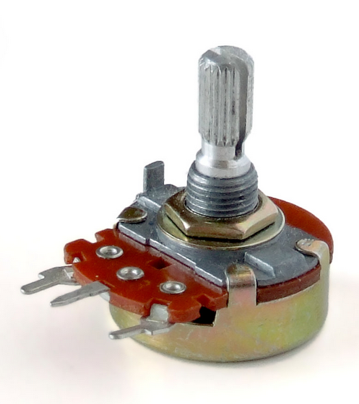
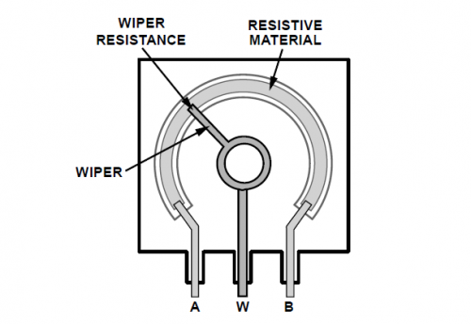
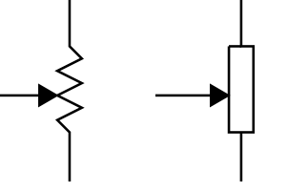
Variable Resistor
A variable resistor is often obtained from a potentiometer, which has a third terminal W with rotating dial (or wiper) so that a variable resistance can be achieved between the terminals A & W, and between terminals B & W.
Resistance between terminals A & B is fixed at R_{AB}
Resistance between A & W = R_{AW}
Resistance between B & W = R_{BW}
A
W
B
A
A
W
W
B
B
Notes:
You have a camera sitting beside you. Its screen view indicates a low battery. You retract it and notice a label on it reads: 3.7 V, 1000 mAh; Minimum 940 mAh or 3.5 Wh.
Another big question for you.

Slide 19
Variable Resistor
A variable resistor (VR) is supposed to be a 2-terminal device.
A potentiometer is a 3-terminal device.
To use a 3-terminal potentiometer as a 2 terminal VR, we can either
leave terminal A or B unconnected,
or connect either (A or B) to W.
A
W
B
A
A
A
W
W
B
B
W
E.g. Not use terminal B
Notes:
You have a camera sitting beside you. Its screen view indicates a low battery. You retract it and notice a label on it reads: 3.7 V, 1000 mAh; Minimum 940 mAh or 3.5 Wh.
Another big question for you.

Slide 20

Variable Resistor
To use a 3-terminal potentiometer as a 2-terminal VR.
A
W
B
A
A
A
W
W
W
B
B
Notes:
You have a camera sitting beside you. Its screen view indicates a low battery. You retract it and notice a label on it reads: 3.7 V, 1000 mAh; Minimum 940 mAh or 3.5 Wh.
Another big question for you.

Slide 21
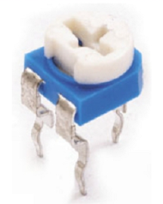
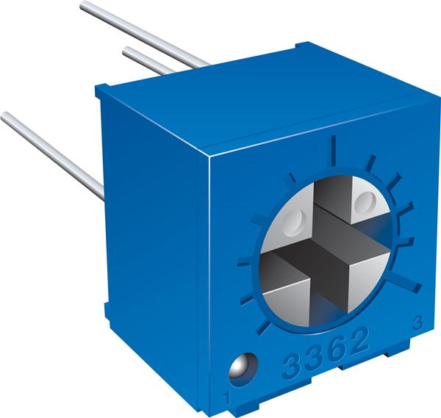
Potentiometer
Trimmer potentiometer or trim-pot is potentiometer not designed for frequent adjustment.
Trimmers are much smaller in size, and usually not so conveniently to be adjusted.
potentiometer
trimmer potentiometer (or trim-pot)
trimmer potentiometer (or trim-pot)
Notes:
You have a camera sitting beside you. Its screen view indicates a low battery. You retract it and notice a label on it reads: 3.7 V, 1000 mAh; Minimum 940 mAh or 3.5 Wh.
Another big question for you.

Slide 22
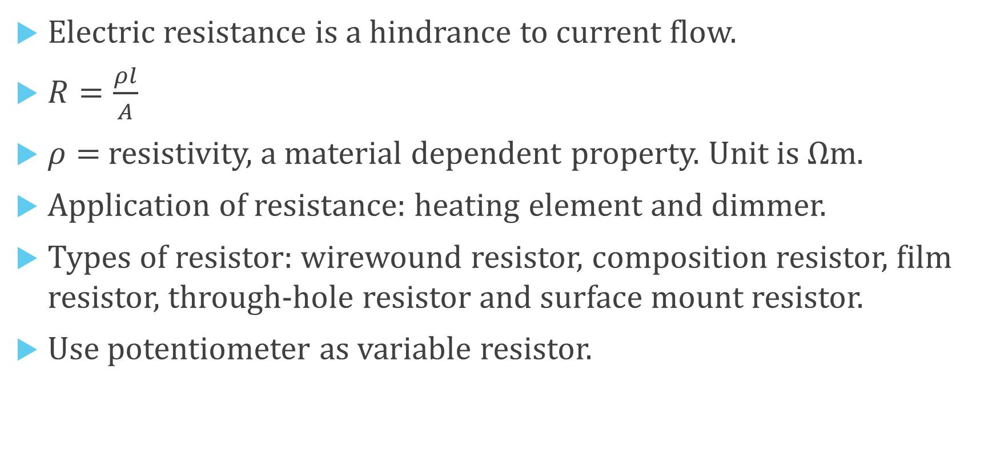
What you have learned?
Electric resistance is a hindrance to current flow.
$R=\frac{ρl}{A}$
$ρ=$ resistivity, a material dependent property. Unit is Ωm.
Application of resistance: heating element and dimmer.
Types of resistor: wirewound resistor, composition resistor, film resistor, through-hole resistor and surface mount resistor.
Use potentiometer as variable resistor.

Slide 23
Coming Up Next
Unit 2, Part B: Resistor Colour Code

